Slide 1
JavaScript Introduction

Slide 2
JavaScript Introduction
JavaScript is a client-side scripting language
It was earlier called as LiveScript
When used in browser JavaScript is considered as a interpreted language

Slide 3
JavaScript – Interpreted Language
When a browser downloads a page with embedded JavaScript, it receives the original source code of the script.
It is then passed to a program called an interpreter, which converts machine codes on the fly.
The browser does this every time it loads the page and does not attempt to cache or validate the page before it is executed.

Slide 4
JavaScript Interpreted Language
JavaScript is a light-weight way of writing applications.
The debugging environment is the browser itself.
The disadvantage is that the source code is visible.
JavaScript is not suitable for writing CPU-intensive applications

Slide 5
JavaScript Engine
In a browser the JavaScript engine interprets the JavaScript on a page.
In a browser the HTML and CSS is rendered by a Layout engine.

Slide 6
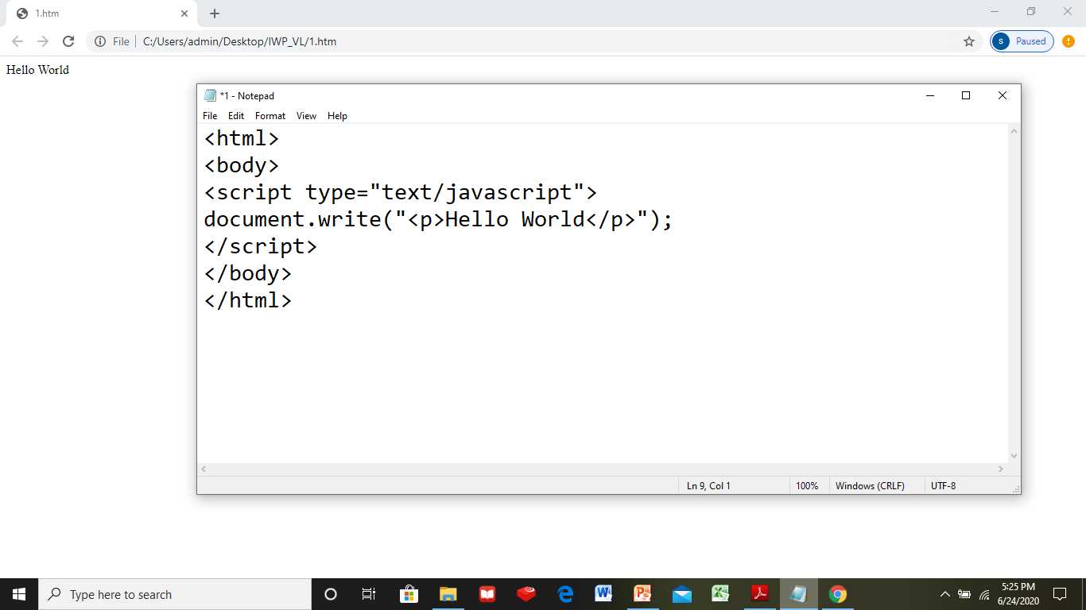
A Simple JavaScript Application

Slide 7
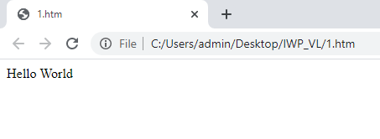
A Simple JavaScript Application

Slide 8
Augmenting a script in webpage
A script is placed within the script tag <script>.
There can be two script blocks, in such case the first block executes first.
There can be script block in head and body, in such case the script block in the head gets executed first.

Slide 9
<script> - Element
To embed JavaScript in a webpage we need <script> tag which is a HTML element.
The script can be embedded inline to a page content or refer to an external script

Slide 10
Attributes of script Tag
type – Specifies the scripting language of the script (values can be text/javascript, text/vbscript, etc.)
language – A deprecated way of specifying the scripting language
src – Specifies the URL or location of an external script file

Slide 11
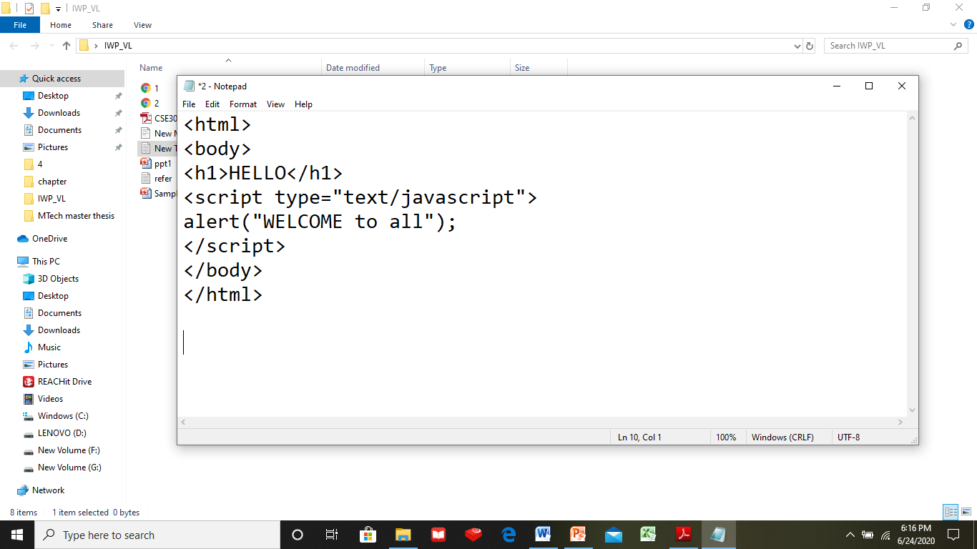
An Example of inline script

Slide 12
Execution order of inline script
Whenever a script tag is encountered it is executed.
If it appears both in the head and body tag the head is executed first followed by body.

Slide 13
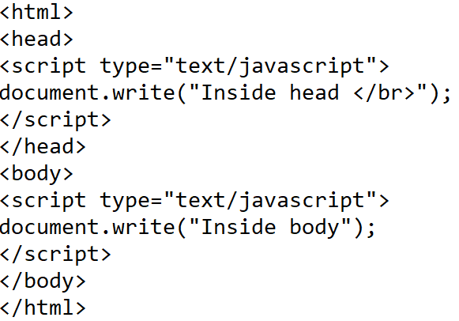
Order of Execution of inline script

Slide 14
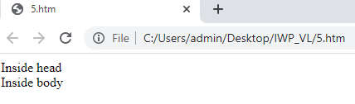
Order of Execution of inline script

Slide 15
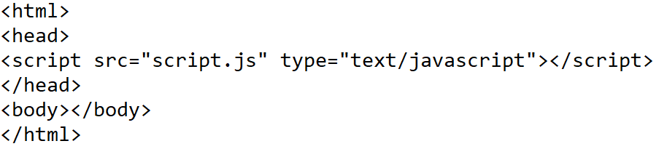

An Example of external script

Slide 16
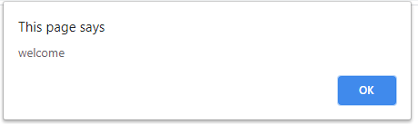
External script

Slide 17
Advantage of using external script
Once an external script is downloaded it is kept in memory.
The next time the page loads it refers to it.
There is no need to re-download the script every time the page is loaded.
For large scripts it suggested to make it external.

Slide 18
<noscript> Element
Sometimes JavaScript can be disabled in browsers.
In such case the alternate content can be specified in the <noscript> block.

Slide 19
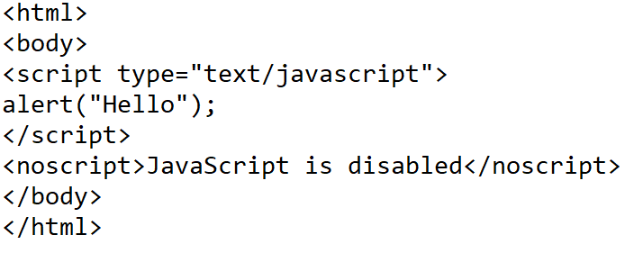
<noscript> Element

Slide 20
Deferred Scripts
The defer attribute of the script tag delays the execution of the script after the DOM has been loaded.
The DOM-Document Object Model is the object representation of all tags and details of the layout page.
Deferred script works only for external script.

Slide 21
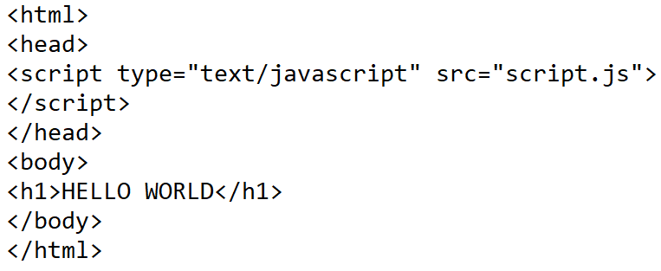

External script

Slide 22
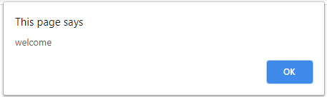

External script

Slide 23
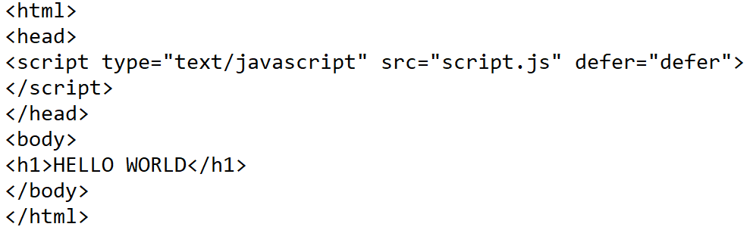
Deferred script Demo

Slide 24
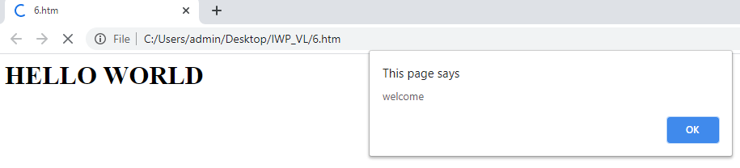
Deferred script Demo

Slide 25
Event-driven Scripts
HTML has certain event attributes.
JavaScript can react to these events.
HTML Event attributes can execute JavaScript code directly
HTML Event attributes can call JavaScript functions

Slide 26
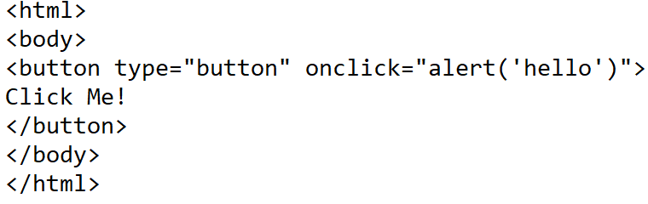
HTML Event executing JavaScript code

Slide 27
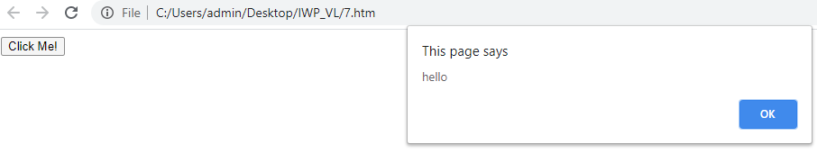
HTML Event executing JavaScript code

Slide 28
Event-driven Scripts
In the above example:
button – Element
onclick – Event
alert(‘hello’) – JavaScript code

Slide 29
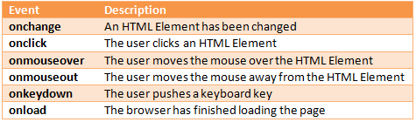
HTML Event Attributes

Slide 30
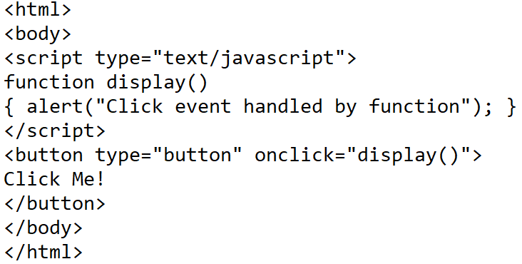
HTML Event executing JavaScript function

Slide 31
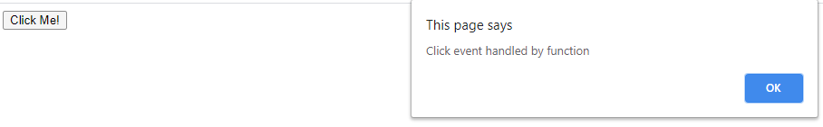
HTML Event executing JavaScript function

Slide 32
Dynamically Loaded Scripts
To load and run an external JavaScript we use src attribute in script tag.
Consider a situation where you need to choose between two JavaScript files at the time of loading.
So the script file has to be loaded dynamically.

Slide 33
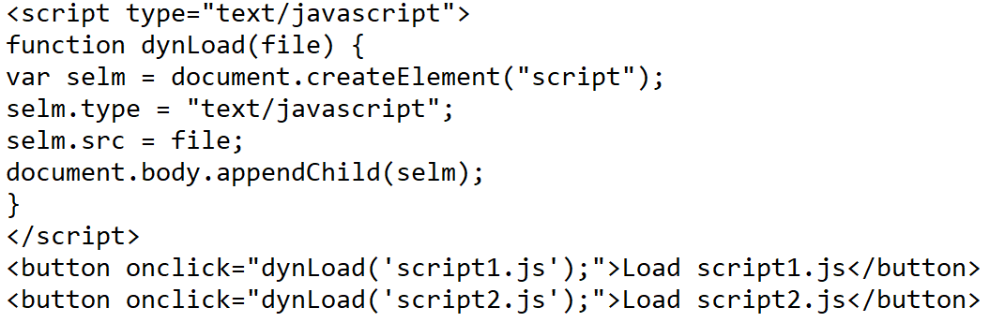


Dynamically Loaded Scripts

Slide 34

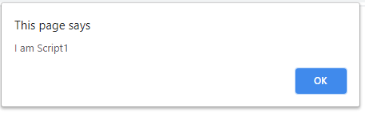
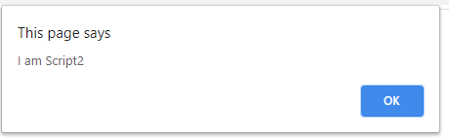
Dynamically Loaded Scripts

Slide 35
JavaScript in URL
Using javascript protocol it is possible to add JavaScript to a URL.
From the URL the browser can interpret the response.
This response will become the source of the document.

Slide 36
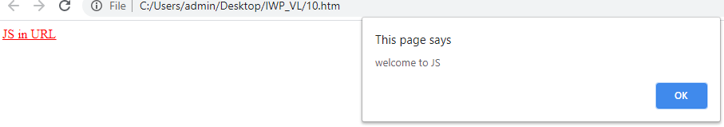
JavaScript in URL

Slide 37
JavaScript Basics
Character Encoding
Case sensitivity
Whitespace and semicolons
Literals
Reserved words
Variables
Memory and garbage collection
Datatypes

Slide 38
Character Encoding
Characters are stored in the computer as bytes
Character encoding maps the entered character into a binary format and then to display a character it converts the binary format back into character.
JavaScript Engine stores literals in UTF-16 format.

Slide 39
Case Sensitivity
JavaScript is case sensitive.
var sum;
var SUM;
var Sum;
The above three variables are different.

Slide 40
Whitespaces and Semicolon
Whitespaces are ignored in JavaScript.
Both the following functions give the same output.
function disp()
{
var a=10;
var b=20;
}
function disp(){var a=10; var b=20;}

Slide 41
Whitespaces and Semicolon
Semicolon specifies the end of a statement.
Semicolon can be omitted if a line break is used.

Slide 42
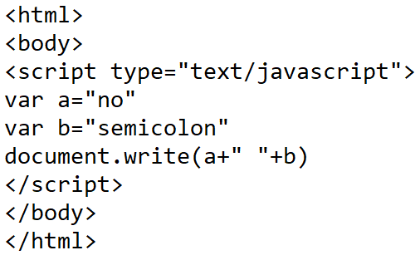

No Semicolon

Slide 43
Literals
A literal is a data value that fixed in the source code.
In JavaScript literals can be:
Integer
Floating-point
Boolean
String
Array
Regular expression
Object

Slide 44
Integer Literals
Numeric literals can be decimal, binary, octal or hexadecimal.
They can be signed or unsigned.

Slide 45
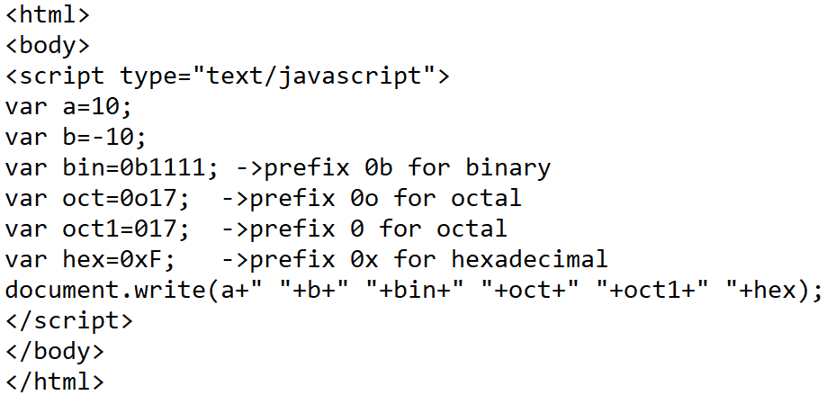

Integer Literals

Slide 46
Floating-point Literals
Represent numbers with floating-decimal point.
The literal can be signed or unsigned
It can have an exponent.

Slide 47
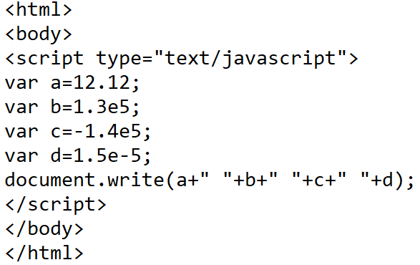

Floating-point Literals

Slide 48
Boolean Literals
Boolean literal can take value true or false.
var pass=true;
var fail=false;

Slide 49
String Literals
String literal contains a chain of zero or more characters.
A string literal will be provided either within double codes or single codes.
To avoid nesting of single or double quotes or slashes in a string prepend them with a backslash.

Slide 50
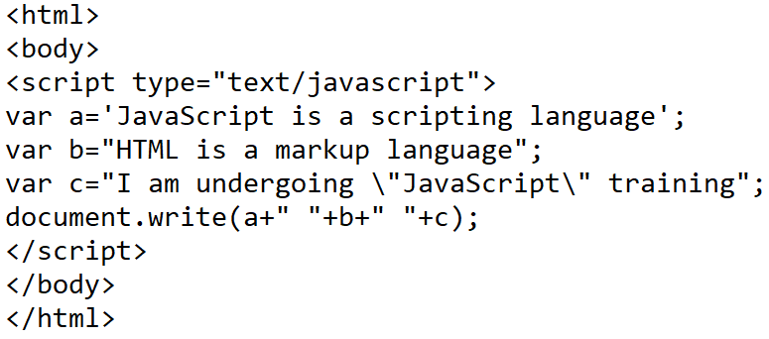
String Literals

Slide 51
Array Literals
An array is a single variable that can hold multiple values and can be indexed.
Arrays can be one dimensional or multi-dimensional.

Slide 52
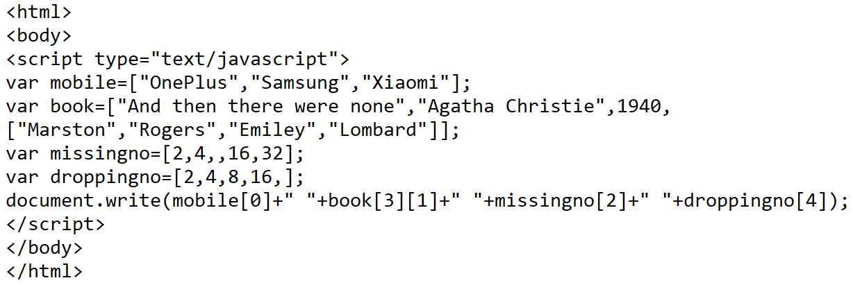
Array Literals

Slide 53
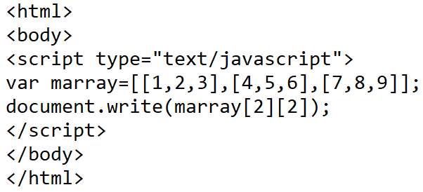

Multi-Dimensional Arrays

Slide 54
Regular Expression Literal
Regular Expression is a pattern that describes a text.
Using this pattern searching, text processing and data validation could be done.
var apat=/hello/; (or)
var bpat=new RegExp(“hello”);

Slide 55
Object Literals
An object literal is a collection of name/value pairs.
To access a member use ‘.’ notation.

Slide 56
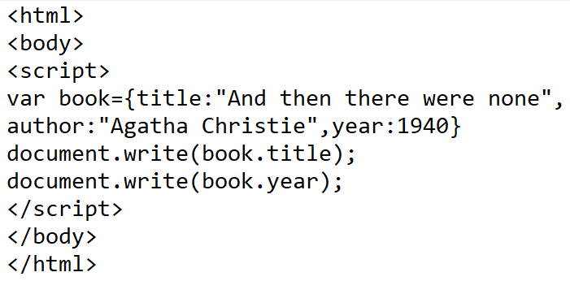

Object Literal

Slide 57
Comments
// Single line comments
/* Multi-line
Comments */

Slide 58
Reserved Words
Reserved words are keywords that have a special meaning in JavaScript.
There are 63 reserved words in JavaScript.
These words cannot be used as identifiers.

Slide 59
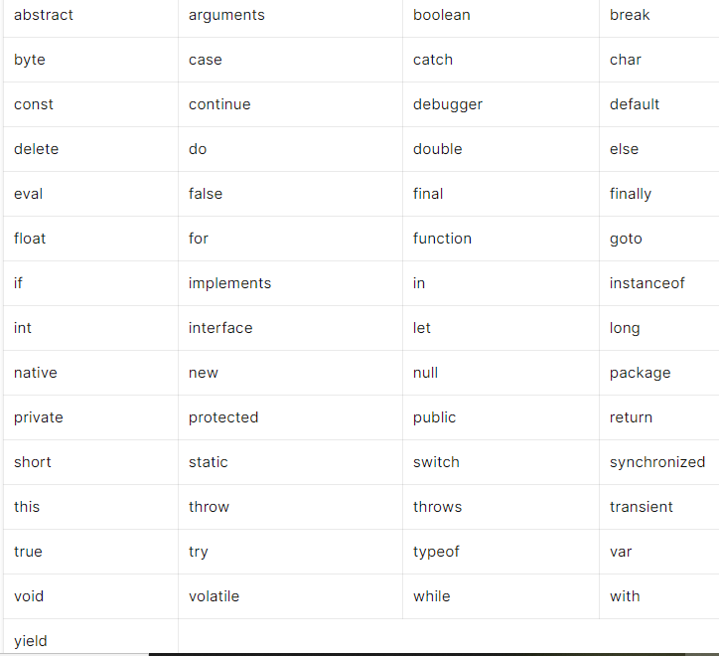
Reserved Words

Slide 60
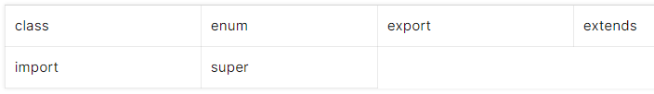
New Reserved Words

Slide 61
Variables
A variable is a named unit of data which can be assigned with a value.
A variable in JavaScript is declared using var keyword.
var runs=70;
var – Indicates that run is a new identifier in the current scope
runs – Identifier
70 – Value assigned to the variable

Slide 62
Variables
Multiple variables can be declared in a single line.
var x,y,z=10; //z is only initialized
var x=10,y=20,z=30;

Slide 63
Implicit Declaration
Declaring a variable without var keyword is called implicit declaration
During implicit declaration the variable gets a global scope.
Such a variable is visible to all blocks, functions and statements.
runs=70;
runs – Implicitly declared variable
70 – Value assigned

Slide 64
Identifiers
Identifiers are the names that is given to variables and functions.
Identifiers are case sensitive
They must begin with a letter or underscore
They should not begin with number but can contain a number
They should not contain punctuation
They should not contain mathematical or logical operators
They should not have spaces
They should not be keywords

Slide 65
Weak Typing
JavaScript is a weakly typed language
Hence the type conversions are not strict
Re-assigning types is possible
Types are not compared directly

Slide 66
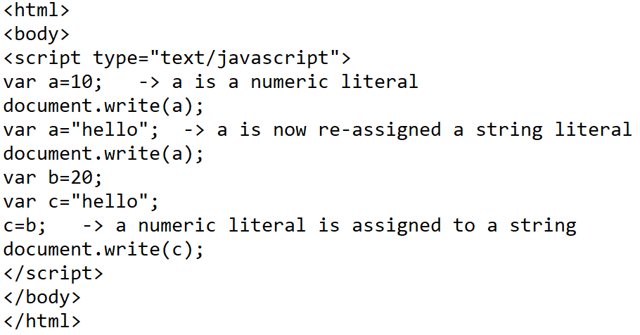
Weak Typing

Slide 67
Memory and Garbage Collection
JavaScript performs automatic memory management through garbage collection.
JavaScript automatically allocates memory when values are declared.
It allocates memory for objects, arrays and functions.

Slide 68
Memory and Garbage Collection
When a program is executing the garbage collector checks if any of its objects are no longer referenced.
When we exit a page all the memory used by JavaScript and DOM will be identified and released.

Slide 69
Memory and Garbage Collection
In JavaScript garbage collection is done using two algorithms:
Reference-counting algorithm
Mark-and-Sweep algorithm

Slide 70
Data Types
JavaScript supports two kinds of datatypes:
Primitive type
Reference type

Slide 71
Primitive Data Types
Primitive types
Number
String
Boolean
null
undefined
(null and undefined cannot store any data)

Slide 72
Reference Types
Reference types – Composite types
Object
Array
Function
Date
RegExp
Error

Slide 73
Data Types - Manipulation
For primitive datatypes when we declare and assign a value, it is stored in the memory location assigned for the identifier.
For reference types a reference is assigned with the memory address that contains the data of the object.

Slide 74
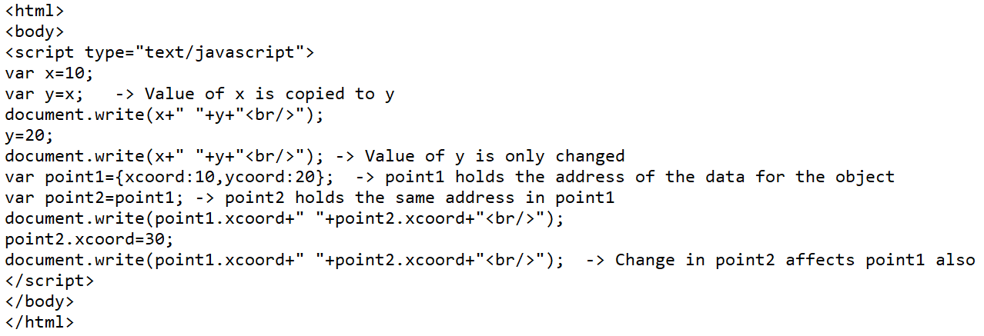

Value vs Reference Manipulation

Slide 75
Primitive type
var x
10

Slide 76
Reference Manipulation
var point1
var point2=point1
83922
83922
xcoord:10
ycoord:20

Slide 77
Understanding null and undefined
null is an object with type as null.
Represents empty value
When a variable is null it is set to empty value
undefined is not an object but has type undefined.
A variable has been created but has no value

Slide 78
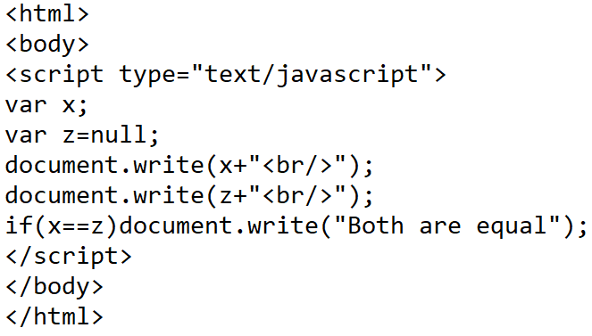

Understanding null and undefined

Slide 79
Determining type
In JavaScript a variable can take any value.
To determine the type of the value a variable has taken “typeof” operator is used.

Slide 80
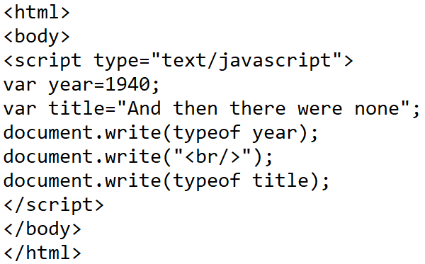

Determining type

Slide 81
Type Conversion
JavaScript supports implicit type conversion.
During implicit conversion the original value of the variable will not be modified.
Example:
var a=10; // a is a number
document.write(a+”<br/>”); // number is converted to string
Example:
if(a) //number converted to Boolean
document.write(“hello”);

Slide 82
Primitive Type Conversion
‘+’ operator has a duality role.
var a=2+2; //Adds numbers
var b=“hello”+”world”; //Concatenates two strings
If we add a number and a string then both are casted as strings
var ab=2+”2”; //22
If we subtract a number and a string we get a number as “-” operator is not dual and is solely numeric.
var ab=3-”2”;//1

Slide 83
Primitive Type Conversion
When we add a number and Boolean, the Boolean is converted to number as + is a numeric operator.
var a=1+true; //1+1=2
var b=1+false;//1+0=1
When we apply + operator for Boolean and a string a concatenation occurs.
var ab=“true”+true; //”truetrue”

Slide 84
Primitive Type Conversion
var a=“null”+null; //”nullnull”
var b=“undefined”+undefined; //”undefinedundefined”
var c=1+null; // 1+0=1
var d=1+undefined; // 1+ NaN = NaN
var e=true+null; //1+0=1
var f=true+undefined; //1+NaN = NaN

Slide 85
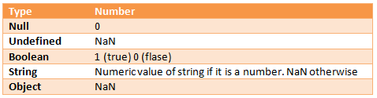
Conversion of different types to Numbers

Slide 86
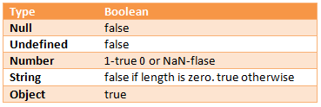
Conversion of different types to Boolean

Slide 87
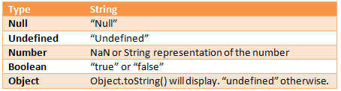
Conversion of different types to Strings

Slide 88
Type Casting
Global object in JavaScript provides methods for explicit type conversions.
For example:
String to Integer casting - parseInt(“12”); //12
String to Float casting - parseFloat(“12.34”); //12.34
Object to String casting - Object.toString();

Slide 89
Composite to Primitive Conversion
Example: Object to Boolean
if (document.body) {….}
Here document.body is an Object in DOM which is converted to true or false
Example: Object to String
var array1=[100];
var str1 = (array1).toString(); //100
var op=str1-50;
document.write(op); //50

Slide 90
Primitive Objects
For primitive types – Number, Boolean and String an respective Objects are also available.
The Objects have properties and methods.
var addend=70;
var adder = new Number(50);
document.write(typeof addend); // Number
document.write(typeof adder); // Object

Slide 91
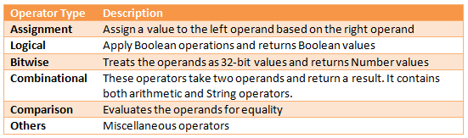
JavaScript Operators

Slide 92
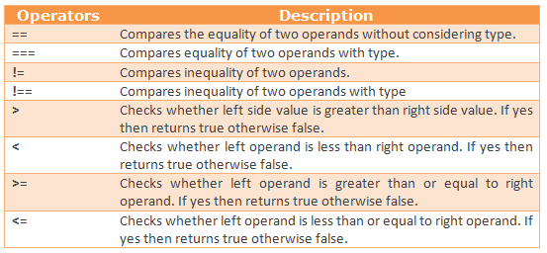
Comparison Operators

Slide 93
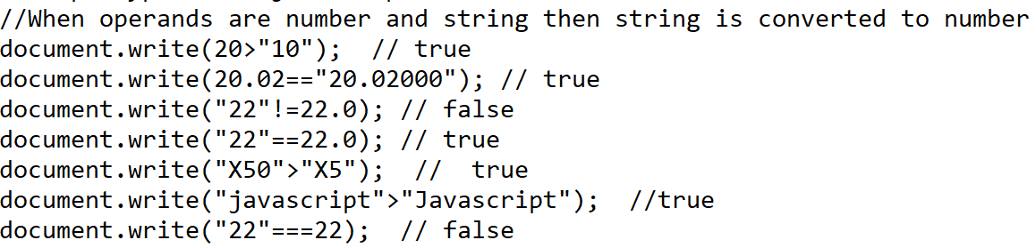
Comparison Operators

Slide 94
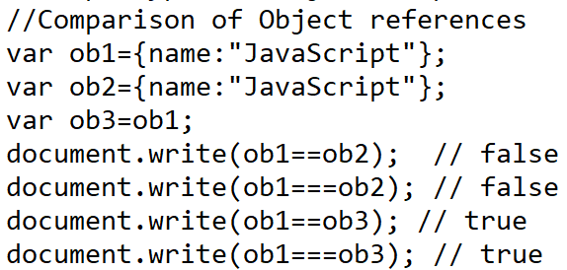
Comparison Operators

Slide 95
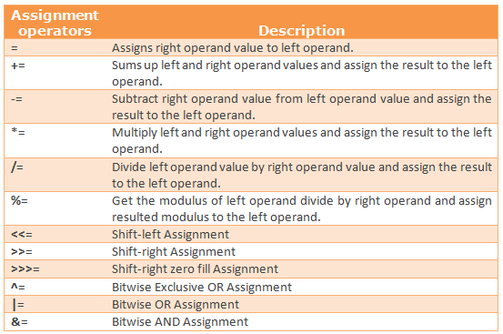
Assignment Operators

Slide 96
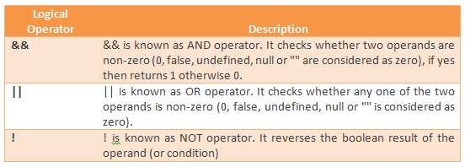
Logical Operators

Slide 97
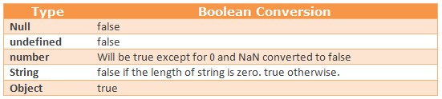
Type Conversion on non Boolean Types

Slide 98
Short-Circuit Evaluation
Incase of logical operators:
For && operator –
false && any code - results in false
It is enough to check the first operand – short circuit
For || operator –
true || any code – results in true
It is enough to check the first operand – short circuit

Slide 99
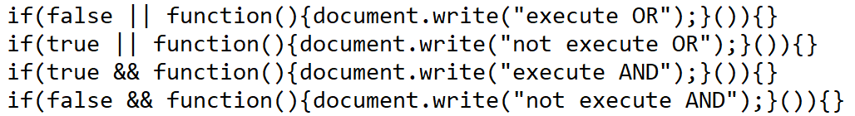

Short-Circuit Logical Operator Demo

Slide 100
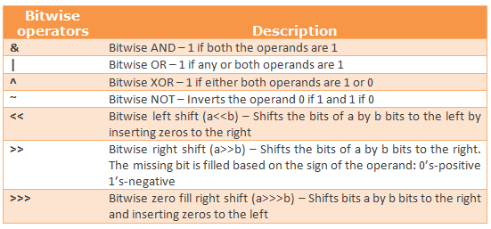
Bitwise Operators

Slide 101
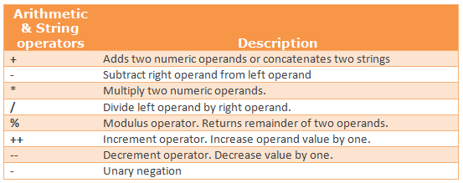
Combinational Operators

Slide 102
Other Operators
Comma operator
Conditional operator
delete operator
Dot operator
in operator
instanceof operator
new operator
typeof operator
void operator

Slide 103
Comma Operator
Comma operator allows to add together multiple expressions.
It returns the result of the right most expression.
The left expressions are also evaluated.
Example:
a=1,b=2,c=3
The result of this expression is 3
The two expressions on the left are also evaluated.

Slide 104
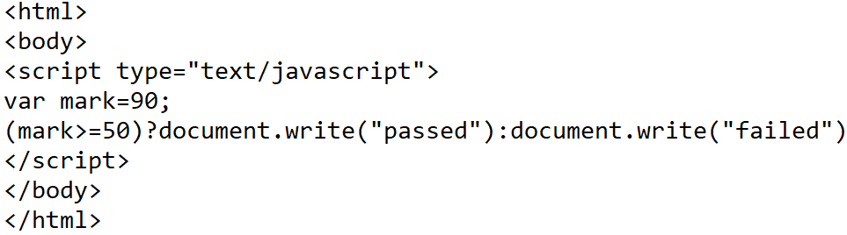

Conditional Operator
Shortcut of if..else statement

Slide 105
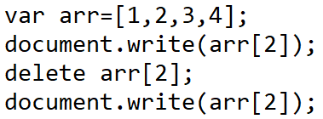

delete Operator
delete operator deletes element from a collection.

Slide 106
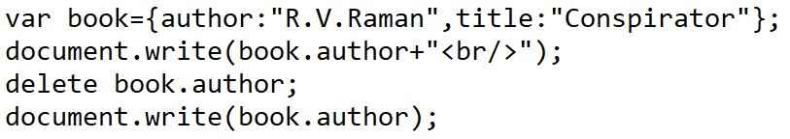

delete Operator
delete operator can delete property or method of an Object.

Slide 107
dot Operator
A dot operator is used to access the property of an Object.
A dot operator can be cascaded as follows:
document.body.innerHTML=“Hello”;

Slide 108

in Operator
The in operator suggests if a property exists in an Object.
Syntax: property in Object

Slide 109

instanceof Operator
The instanceof operator suggests if an object is an instanceof another Object.
Syntax: objectname instanceof objecttype

Slide 110
new Operator
The new operator creates objects by calling constructor
Syntax: objectname =new objecttype([parameters])

Slide 111
typeof Operator
Determines the type of the variable or object
Syntax: typeof variable

Slide 112

void Operator
The void operator forces the result of an evaluated expression to be undefined.
Syntax: javascript:void()
In the example below the backgroundcolor of the page will not be set to blue.

Slide 113
Statements
Conditional statement
Multipath statement
Loops and iterators
Loop interrupts
Var – declares variables
with

Slide 114


Conditional statements - if

Slide 115


Conditional statements – elseif ladder

Slide 116


Conditional statement – nested if

Slide 117


switch..case

Slide 118
switch..case
case and default are labels

Slide 119


Looping statements - for

Slide 120
Looping statement – for..in
The for..in loop enumerates the properties of an array or object.
Syntax:
for (variablename in object)
{ //statements}

Slide 121


Looping statements – for..in

Slide 122


Looping statements – for..in

Slide 123
Looping statement – for each..in
The for each..in loop enumerates the property values of an object.
The for each..in loop works only for Mozilla variants
Syntax:
for each (variablename in object)
{ //statements}

Slide 124

Looping statement – for each..in

Slide 125


Looping statement – while

Slide 126


Looping statement – do..while

Slide 127
Loop or block interrupts
break – exits a loop or switch prematurely
continue – restarts a loops
label – identifier of a loop

Slide 128


break

Slide 129


break using label

Slide 130


continue statement

Slide 131
with statement
with statement lets access members of cascaded objects using shortcut.
Syntax:
with(object)
{//statement}

Slide 132


with statement
The above can be written as follows:

Slide 133
JavaScript Pop-up boxes
alert() – It is a pop-up that displays some text or result
confirm() – It is a pop-up that asks the user to confirm by clicking “OK” or “cancel”
prompt() – This pop-up fetches input from the user.

Slide 134


JavaScript Pop-up box – alert()

Slide 135

JavaScript Pop-up box – confirm()

Slide 136



JavaScript Pop-up box – confirm()

Slide 137



JavaScript Pop-up box – prompt()

Slide 138
Exercises
Create a variable called c, assign a + b to it, and display the result in an alert box.
On one single line, declare three variables with the following names and values:
firstName = "John" lastName = "Doe" age = 35

Slide 139
Use the correct assignment operator that will result in x being 50 (same as x = x * y).
var length = 16; //
var lastName = "Johnson"; //
var x = {
firstName: "John",
lastName: "Doe"
}; //

Slide 140

Alert "John" by extracting information from the person object

Slide 141

Add the following property and value to the person object: country: Norway.

Slide 142

Create an object called person with name = John, age = 50. Then, access the object to alert("John is 50").

Slide 143


Slide 144
How to find the length of the string?
- Use the length property to alert the length of txt.

Slide 145


Slide 146

Use the splice() method to remove "Orange" and "Apple" from fruits.

Slide 147
REFERENCE
Alexei White, JavaScript Programmer’s Reference, Wrox, ISBN:978-81-265-2363-4

